Slide 1

Problem statement
Exercise 4.3

Slide 2

Theoretical results
Anti-model:
An interpretation i which evaluates the formula U as false is called an anti-
model of U: i:{p1 …,pn}->{T,F} such that i(U)=F
DNF:
A formula is in disjunctive normal form(DNF), if it is written as a disjunction of cubes:
The open branches of the negation of a formula provide the anti-models of that formula.

Slide 3
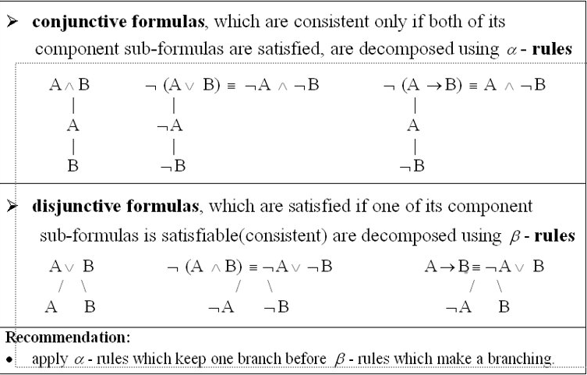

Slide 4
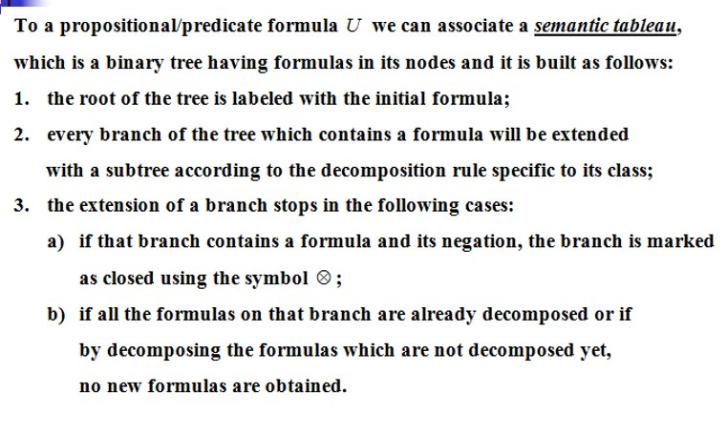

Slide 5
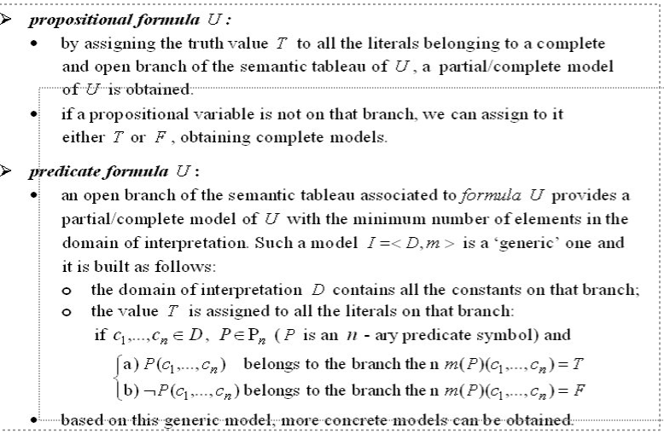

Slide 6
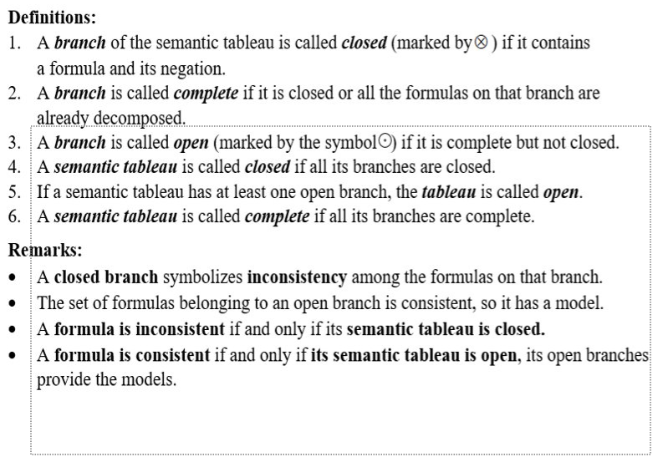

Slide 7
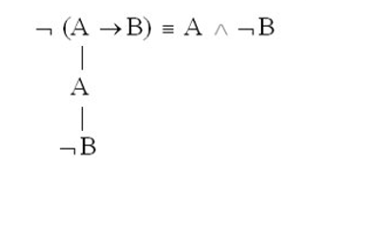
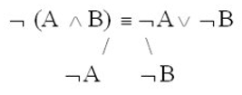
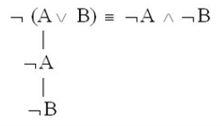
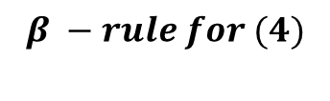

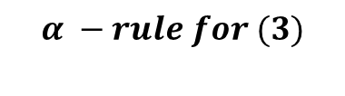
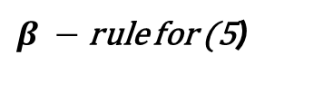
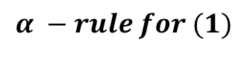
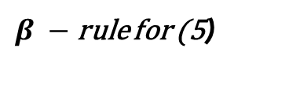

Solution: semantic tableaux
$$α −rules$$
$$β −rule$$
¬U3 = ¬(p →(q ∧ r) ∨ ( q ∧ ¬p)) (1)
p (2)
¬((q ∧ r) ∨ ( q ∧ ¬p)) (3)
¬(q ∧ r) (4)
¬ ( q ∧ ¬p) (5)
¬q ¬r
¬q p ¬q p
$$α −rule for (1)$$
$$α −rule for (3)$$
$$β −rule for (4)$$
$β −$rule for (5)
$β −$rule for (5)
⊙
⊙
⊙
⊙

Slide 8
Conclusions:
Because we have at least one open branch the tableaux is open.
¬U3 is consistent because its semantic tableaux is open, and its open branches provide anti-models.
DNF(¬U3) = (¬q ∧ ¬q) ∨ (¬ q ∧ p) ∨ (¬ r ∧¬q) ∨ (¬ r ∧ p)
= (¬q) ∨ (¬ q ∧ p) ∨ (¬ r ∧¬q) ∨ (¬ r ∧ p)
≡ (¬q) ∨ (¬ r ∧¬q) ∨ (¬ r ∧ p) (we apply the absorption law)
≡ (¬q) ∨ (¬ r ∧ p) (we apply the absorption law)
The branch represented by the cube ¬q provides the models:
I1:{p, q, r} → {T, F}, I1(p) = T, I1(q) = F, I1(r) = T ;I1(¬U3) = T, I1(U3) = F
I2:{p, q, r} → {T, F}, I2(p) = T, I2(q) = F, I2(r) = F ;I2(¬U3) = T, I2(U3) = F
I3:{p, q, r} → {T, F}, I3(p) = F, I3(q) = F, I3(r) = T ;I3(¬U3) = T, I3(U3) = F
I4:{p, q, r} → {T, F}, I4(p) = F, I4(q) = F, I4(r) = F ;I4(¬U3) = T, I4(U3) = F
The branch represented by the cube ¬ r ∧ p provides the models:
I5:{p, q, r} → {T, F}, I5(p) = T, I5(q) = T, I5(r) = F ;I5(¬U3) = T, I5(U3) = F
I6:{p, q, r} → {T, F}, I6(p) = T, I6(q) = F, I6(r) = F ;I6(¬U3) = T, I6(U3) = F
I2=I6 U3 has 5 anti-models
The models of ¬U3 provide the anti-models of U3: I1, I2, I3, I4, I5

